Slide 1
Advanced Vehicle Safety System(AVSS).
A system developed to ensure safety of you and your vehicles.

Slide 2


Presentation on
“Advanced Vehicle Safety System”
Project Carried out at:
Department of ECE, K.I.T, Tiptur
Under the Guidance:
Prof.Lohith M S
Assistant Professor,
Dept. of ECE, KIT
Head of the Department :
Mr. Yogananda G S
Associate Professor, HOD
Dept. of ECE, KIT
Presented by
1.Prajwal I (1KI18EC031)
2.Prajwal N (1KI18EC032)
3.Ranganathaswamy Y S (1KI18EC035)
4.Syed Arfath (1KI18EC050)

Slide 3
Contents
Introduction
Problem Statement
Literature Review
Objectives
Proposed System
Project Description
Hardware Requirements
Software Requirements
References
Conclusion

Slide 4
Introduction
With over 1.3 million people dying in road crashes each year, we now need a reliable and robust vehicle safety system more than ever. A system that is designed to be forgiving of human errors. Because according to studies human errors are the major reason for vehicle accidents which can be overcome by a reliable safety system. A system that can ensure safety of drivers, passengers and safety of the vehicle itself from burglaries.
Thus we decided to solve this problem by building a system that includes many advanced technologies such as Artificial Intelligence, Machine Learning, Computer Vision, Deep Learning and IOT to efficiently tackle the problem.

Slide 5
Problem Statement
The Safe System approach to road safety aims to ensure a safe transport system for all road users. Such an approach takes into account people’s vulnerability to serious injuries in road traffic crashes and recognizes that the system should be designed to be forgiving of human error.
Approximately 1.35 million people die in road crashes each year; on average 3,700 people lose their lives every day on the roads. An additional 20-50 million suffer non-fatal injuries, often resulting in long-term disabilities.
Various studies have suggested that around 20% of all road accidents are fatigue-related, up to 50% on certain roads.
Every year around 3,597 people die due to potholes. More than 30% of people die due to potholes. The Ministry of Road Transport and Highways provided figures that over 9300 deaths, 25000 injured in the last three years due to potholes and more than 25,000 people are getting injured due to potholes.
Police data show motor vehicle theft the least-solved crime. 44,158 cases of motor vehicle theft reported in 2018; only 19.6% cases solved.

Slide 6
Literature review
Drowsiness Detection:- IEEE paper of Praveen Kumar K P and their crew from Sivasubramanya College, Chennai on “Driver assistance system using Raspberry pi & Harr Cascade Classifier”, provides a technique for finding a drowsiness of a driver by using Harr Cascade Classifier in open-CV.
Pothole Detection:- A research paper on “Detecting and Counting of Potholes using Image Processing Techniques” presented by the MTech students from Puducherry ,show the various techniques used to find the pothole in images. By their research paper we came to know that 82-91% of accuracy in detection can be obtained by using Edge-Detection and Fuzzy C means Clustering algorithms.

Slide 7
Contd..
Lane Detection: A Chinese Research paper on “ Lane detection of Curving road for Structural highway with straight curve model on vision” by Wang brothers, which provides a geometric technique to find the relative movement of the vehicle with the lane of the road.
Intruder Detection:- The paper published by the final year students of Vellammal Engineering College ,Chennai in the year 2015 on “Image Processing Based Intruder Detection”, which identifies the intruder by using neural network.

Slide 8
Objectives
Vehicle safety has become an objective to save “people” from injuries in the event of road accidents.
Nowadays, the driver safety in the car is one of the most wanted system to avoid vehicle accidents and vehicle thefts.
Our objective of this project is to ensure the safety of driver and vehicles itself.
We are detecting if the driver is sleeping through tracking different physiological behaviours such as blinking of eyes and yawning.
We are ensuring the vehicle is in the correct path by tracking the lanes on the road.
We are detecting potholes in the roads earlier to avoid potholes and crashes related to them.
We are detecting faces of the intruders thus avoiding vehicle thefts.

Slide 9
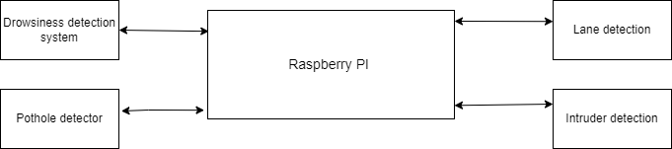
Proposed System
Fig a :- Advanced Vehicle Safety System

Slide 10
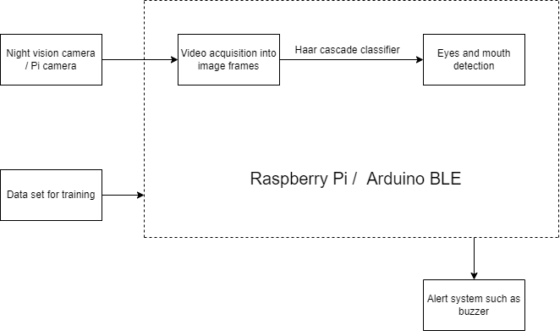
Fig b :- Driver Drowsiness System

Slide 11
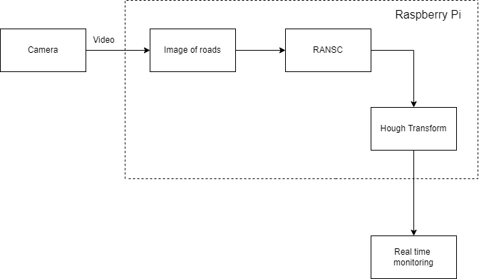
Fig c :- Lane Detection System

Slide 12
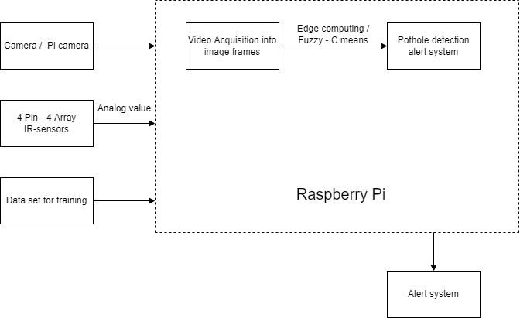
Fig d :- Pothole Detection System

Slide 13
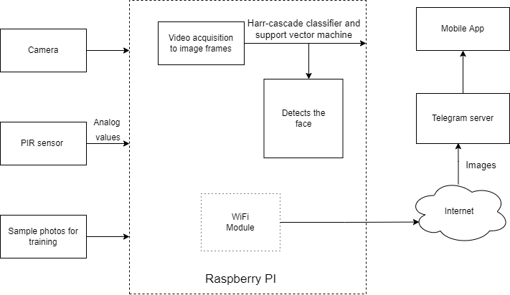
Fig e :- Anti Intruder System

Slide 14
Project Description
Hardware requirements
Raspberry Pi-4
Broadcom BCM2711
1 GB Ram
Cameras - 4
PIR sensor
LEDs
IR sensor(4 pin-4 array)
Buzzers
Jumpers
HDMI cable/ VGA cable

Slide 15
Software requirements
Raspbian OS, Ubuntu x86
Programming Languages - Python
Simulation tools - Visual designer for Raspberry Pi or Simulink
Designing tool - Fritzing
VCS - Git and Github
Supportive python libraries -
Numpy
Open CV
Imutil
Scikit-learn, keras
Pytorch
Matplotlib, Seaborn
Rpi
For analysis – Jupyter Notebook
IDE - Visual studio or pycharm
3d Tools- For Prototyping the model

Slide 16
References
Vigneshwar. K [1] and Hema Kumar. B [2] “Detection and Counting of pothole using Image Processing Techniques”.
S.Adhav [3] and R.Manthira moorthi [4] and G.Prethija [5] “Image processing based intruder Detection using Raspberry PI”.
Huifeng Wang[6] , Guiping Wang,[7] , Yunfei Wang[8] and others “Lane Detection of Curving Road for Structural High-way with Straight-curve Model on Vision”.
Praveen Kumar V [9], Aravind P[10] , Nachammai Devi Pooja S [11] and their subordinates,” Driver Assistance System using Raspberry Pi and
Harr Cascade Classifiers”(IEEE Xplore Part Number: CFP21K74-ART; ISBN: 978-0-7381-1327-2)

Slide 17
Conclusion
We are concluding that by using Advanced Technologies such as Artificial Intelligence, Machine Learning, Computer Vision, Deep Learning and IOT we can implement a efficient, reliable and robust vehicle safety system which can ensure safety of driver and passengers and security of the vehicles itself.

Slide 18
Thank you!

